Slide 1
Actor-Centric Model

Slide 2
There are two main types of RL methods out there:
Value Based: They try to find or approximate the optimal value function, which is a mapping between an action and a value. The higher the value, the better the action. The most famous algorithm is Q learning and all its enhancements like Deep Q Networks, Double Dueling Q Networks, etc
Policy-Based: Policy-Based algorithms like Policy Gradients and REINFORCE try to find the optimal policy directly without the Q -value as a middleman.
Each method has their advantages. For example, policy-based are better for continuous and stochastic environments, have a faster convergence, while Value based are more sample efficient and steady.

Slide 3
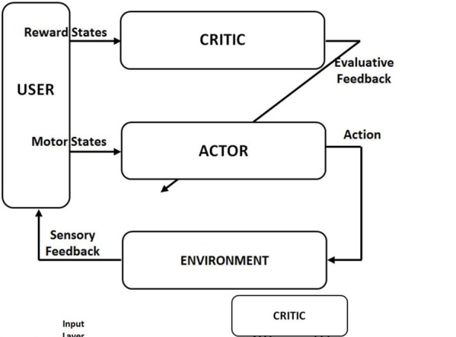

Slide 4
The next obvious step is… to try to merge them. And this is how the Actor-Critic was born. Actor-Critics aim to take advantage of all the good stuff from both value-based and policy-based while eliminating all their drawbacks. And how do they do this?
The principal idea is to split the model in two: one for computing an action based on a state and another one to produce the Q values of the action.
The actor takes as input the state and outputs the best action. It essentially controls how the agent behaves by learning the optimal policy (policy-based). The critic, on the other hand, evaluates the action by computing the value function (value based). Those two models participate in a game where they both get better in their own role as the time passes. The result is that the overall architecture will learn to play the game more efficiently than the two methods separately.

Slide 5
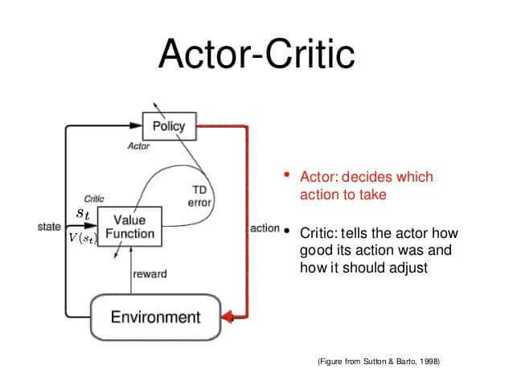
A good analogy of the actor-critic is a young boy with his mother. The child (actor) constantly tries new things and exploring the environment around him. He eats its own toys, he touches the hot oven, he bangs his head in the wall (I mean why not). His mother (the critic) watches him and either criticize or compliment him. The child listen to what his mother told him and adjust his behavior. As the kid grows, he learns what actions are bad or good and he essentially learns to play the game called life. That’s exactly the same way actor-critic works.

Slide 6
The actor can be a function approximator like a neural network and its task is to produce the best action for a given state. Of course, it can be a fully connected neural network or a convolutional or anything else. The critic is another function approximator, which receives as input the environment and the action by the actor, concatenates them and output the action value (Q-value) for the given pair. Let me remind you for a sec that the Q value is essentially the maximum future reward.
The training of the two networks is performed separately and it uses gradient ascent (to find the global maximum and not the minimum) to update both their weights. As time passes, the actor is learning to produce better and better actions (he is starting to learn the policy) and the critic is getting better and better at evaluating those actions. It is important to notice that the update of the weights happen at each step (TD Learning) and not at the end of the episode, opposed to policy gradients.
Actor critics have proven able to learn big, complex environments and they have used in lots of famous 2d and 3d games, such as Doom, Super Mario, and others.

Slide 7
